Slide 1
Applied Data Science Capstone Project
By Capraru Ovidiu

Slide 2
Profit and risk
Comparing profit to risk has always been a prime objective in starting a new business
But one main risk to business and especially to small or new businesses is competition

Slide 3
Competition
While risk based on competition is not so much a problem for big businesses or it may even be a tool a small or starting business can be killed easily by it.
To resolve this problem sometimes its's better to just not compere.
And so we come In.

Slide 4
What we do
We find and manipulate data in order to know how the world works and make predictions upon it
All the work we do is based on real science with real data and real math so all the answers we find are the best king of real, statistically real

Slide 5
How de we help you
We will help you by finding the business type predominant in a area along with their distribution.
By using this data you can make a decision on what kind of business you want to open in the said zone more easely
Along with the high customer density zone

Slide 6
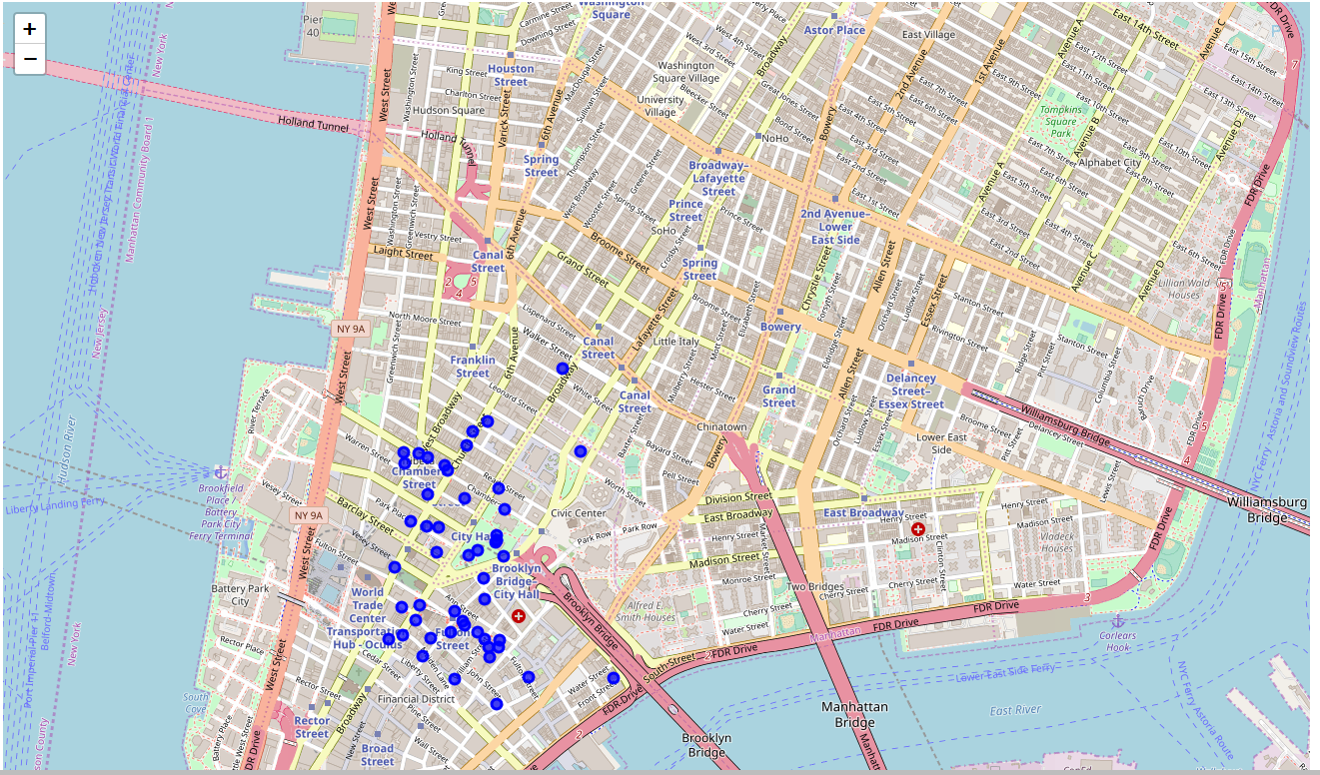
Some of our results

Slide 7
Conclusion and future directions
Good understanding of our provided service
Helpful advice sustained by math and statistics
Further development in prediction of profit/risk along with profit/risk/location based on population density and region economy

